Slide 1
Cloud Security – Container Edition
CyberCamp 2019
Ricky Payne CISSP, AWS CSA, RHCE, RHCSA, Security+ , BS-IST, AS-CET

Slide 2
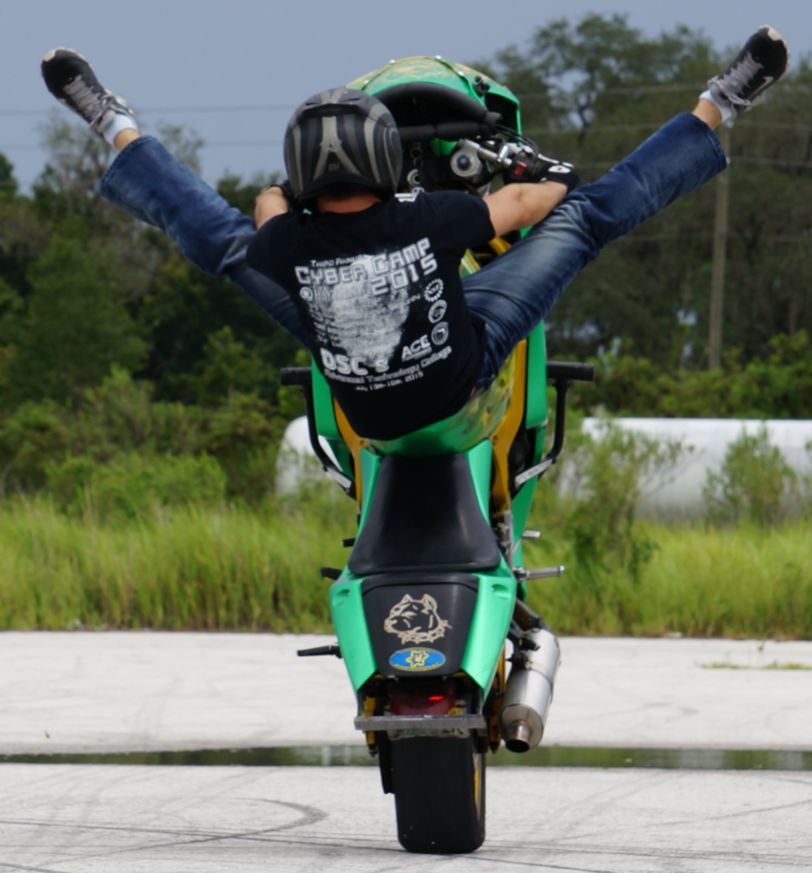
About Me
Over 13.5 years of progressive DevSecOps experience from Intern to Security Analyst -> Architect -> CSO -> Sr. Eng
Built and operationalized vuln mgmt process for 1000s of globally distributed machines
Built “Gold Standard” federal security programs that produced 10+ federally certified systems.
Expert generalist: from pre-sales proposal work, policy and reference architecture development, requirements decomposition into agile sprints, proof of concepts, implementation, operations, and technical training to incident response.
Mentored/taught Windows and Linux security at CyberPatriot/CyberCamps since 2013. Accomplishments include 1st and 2nd in State and 1st in Regionals.
As a Sr. SecEng for a global, Silicon Valley InsureTech firm, engaged in all SecOps activities for 1000s of heterogeneous machines across multiple cloud technologies
Ricky Payne
CISSP, AWS CSA, RHCE, RHCSA, Security+, BS-IST, AS-CET
grep.rickp@gmail.com
@RickPayne929

Slide 3
Agenda
Presentation scope / goal
Container ecosystem
Cloud native ecosystem
What are containers?
Orchestration service example
What companies support them?
What’s the fuss about?
Deployment paradigm shift
Usage: At what scale?
Container threats
Container vulnerabilities
Container incident
Container risks
Securing containers
What we learned
Hands-on session in room Eng1-187

Slide 4
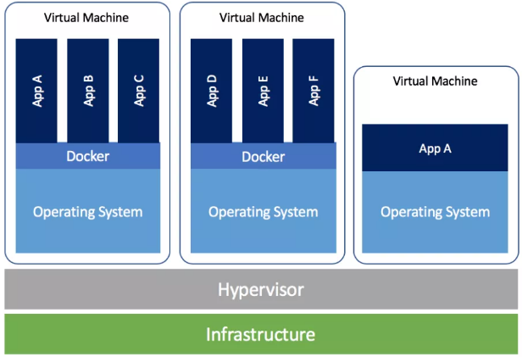
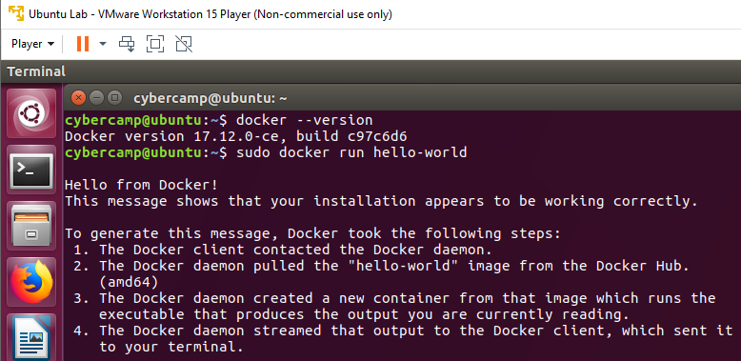
Presentation scope / goal
Scope – Focusing on running a Docker container inside a VM.
Goal – Prepare students for a hands-on Docker session.
Notes:
Just scratching the surface. Windows containers. Win/Lin at the same time.
Docker CE vs EE, Google Kubernetes, Apache Mesos
Image source: https://blog.docker.com/2018/08/containers-replacing-virtual-machines/
Good read: https://mesosphere.com/blog/docker-vs-kubernetes-vs-apache-mesos/

Slide 5
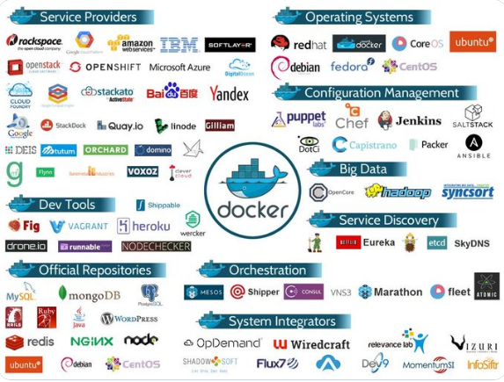
Container ecosystem
Docker’s partner ecosystem.
Notes:
Student Q&A to baseline understanding.
Relate via phones – iCloud, Samsung Cloud

Slide 6
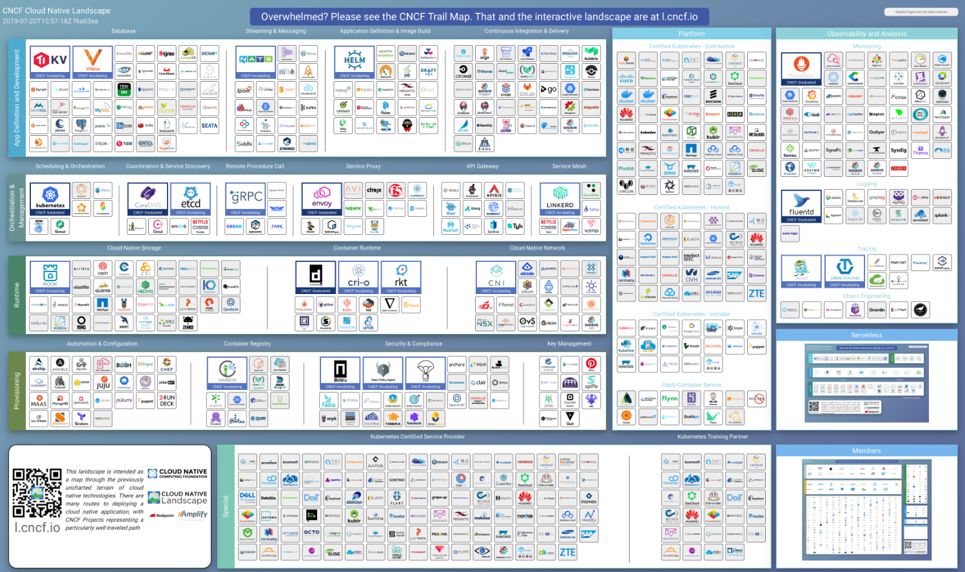
Cloud native ecosystem
Cloud native ecosystem
Notes:
Image source: https://github.com/cncf/landscape/blob/master/README.md#trail-map Cloud Native Computing Foundation (CCNF)

Slide 7
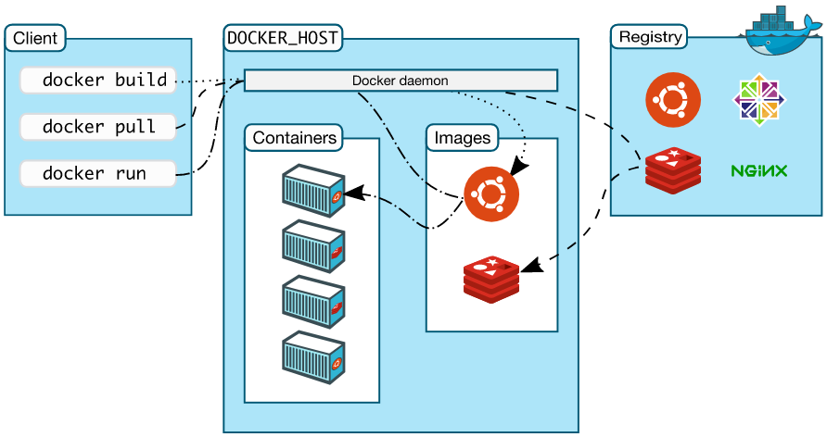
What are containers?
Image – A package that contains all the files required to run a container.¹
Container - A method for packaging and securely running an application within an application virtualization environment. Also known as an application container or a server application container.¹
Notes:
Student Q&A to baseline understanding.
Relate via phones – iCloud, Samsung Cloud
Hands-on: hello-world
Image source²: https://docs.docker.com/engine/docker-overview/

Slide 8
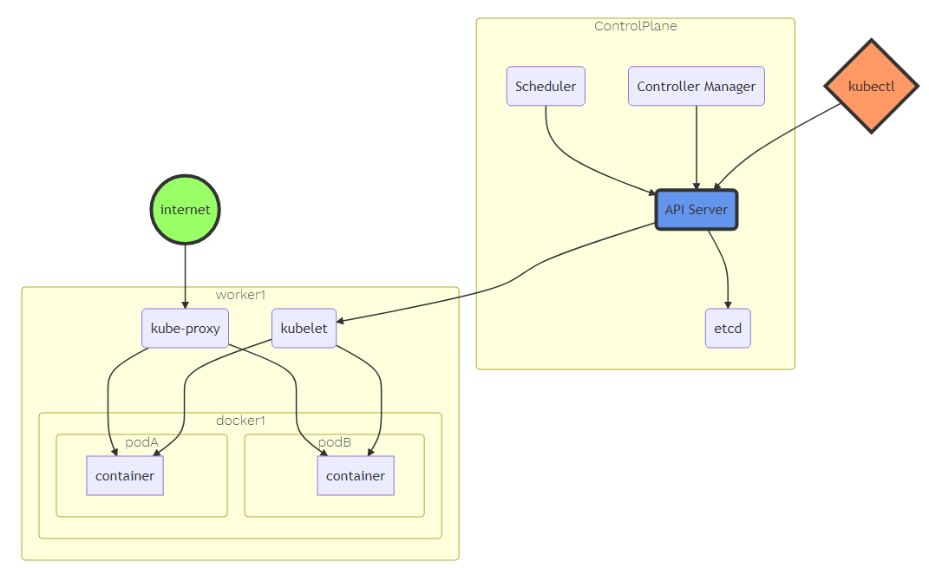
Orchestration service example
Host & Container
Orchestration
Notes:
Image source: https://eksworkshop.com/introduction/architecture/architecture_control_and_data_overview/

Slide 9





What companies support them?
RedHat, Google, AWS, VMware, Microsoft, Dell have been partnered, teamed, integrated, supporting…since 2014³.

Slide 10



What’s the fuss about?
10x increase in scalability
+50% app deploy productivity increase
Netherlands government realized 100x faster deployments 5 -> 500/mo
Notes:
Source: https://www.docker.com/taxonomy/term/4949

Slide 11
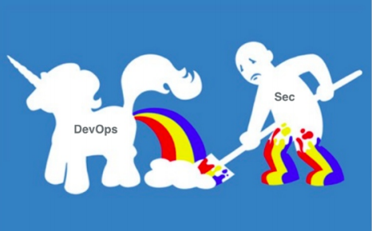
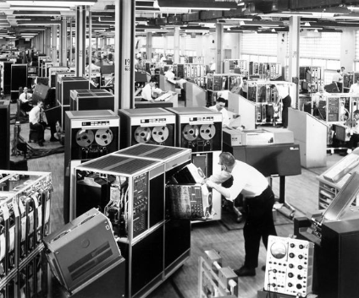
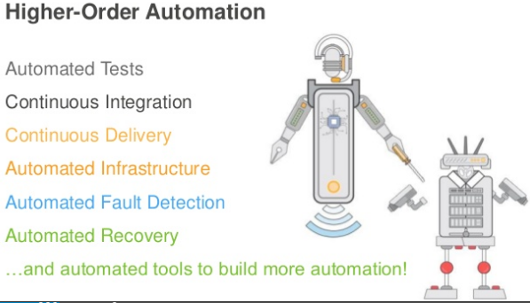
Deployment paradigm shift
Now a developer must become fluent in software testing, deployment, telemetry and even security. Developers will be responsible for securing their own work!⁴
Notes:
Source: https://www.owasp.org/images/1/17/Dirk_Wetter_-_Docker_Security_Brussels.pdf
Source: https://www.slideshare.net/AmazonWebServices/arc401-cloud-first-new-architecture-for-new-infrastructure

Slide 12
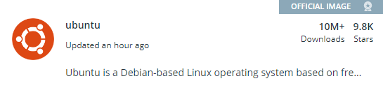
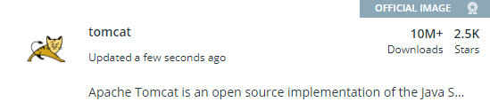
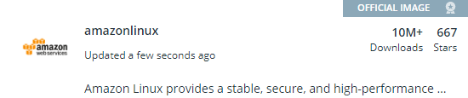
Usage: At what scale?
A quick browse of Docker Hub’s image repo shows the popularity with well over 1 BILLION downloads.
Notes:
Source: https://hub.docker.com/search?q=&type=image

Slide 13
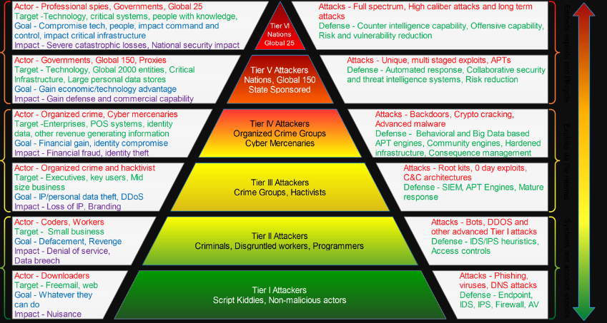
Container Threats?
Do and will they apply to containers?
A threat is defined in NIST Special Publication (SP) 800-30 as “any circumstance or event with the potential to adversely impact organizational operations and assets, individuals, other organizations, or the Nation through an information system via unauthorized access, destruction, disclosure, or modification of information, and/or denial of service.”
Notes:
https://www.recordedfuture.com/prioritizing-cyber-threats/
Virus, Bots, DDoS, 0 Day, Backdoors, Crypto
Unintentional insider threat?

Slide 14
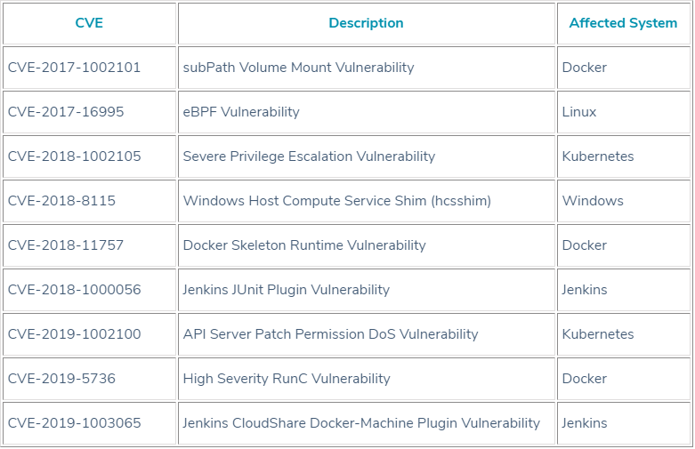
Container Vulnerabilities
CVE-2019-5736: High Severity RunC Vulnerability
This vulnerability allows an attacker to potentially compromise the container host. The vulnerability allows a malicious container to overwrite the host runc binary and gain root-level code execution capability on the host.
Notes:
Source: https://blog.aquasec.com/container-security-vulnerabilities

Slide 15
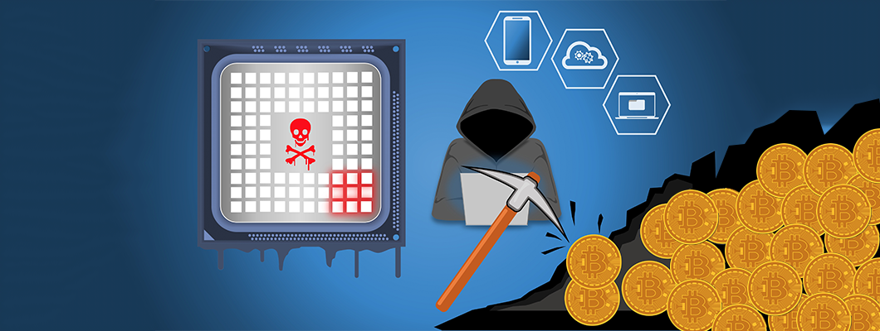
Container incident
Docker Hub – 17 Cryptomining containers. 5M downloads
Notes:
https://www.securitynow.com/author.asp?section_id=716&doc_id=744967
Image source: https://stopad.io/blog/cryptomining-malware-what-to-expect-2018
What’s next?

Slide 16
Container risks
Awareness & Training – Image source integrity
Access Control – Container backdoors?
Auditing – Visibility across orchestration service, Host, Container
Identification and Authentication – Embedded secrets
Least Functionality – Limit services & exposed ports
Permissions – PoLP across orchestration service, Host, Container
Patching – Vuln mgmt across orchestration service, Host, Container
Notes:
https://nvlpubs.nist.gov/nistpubs/SpecialPublications/NIST.SP.800-190.pdf
https://hub.docker.com/ - Official images, check Dockerfile
https://www.alpinelinux.org/posts/Docker-image-vulnerability-CVE-2019-5021.html

Slide 17
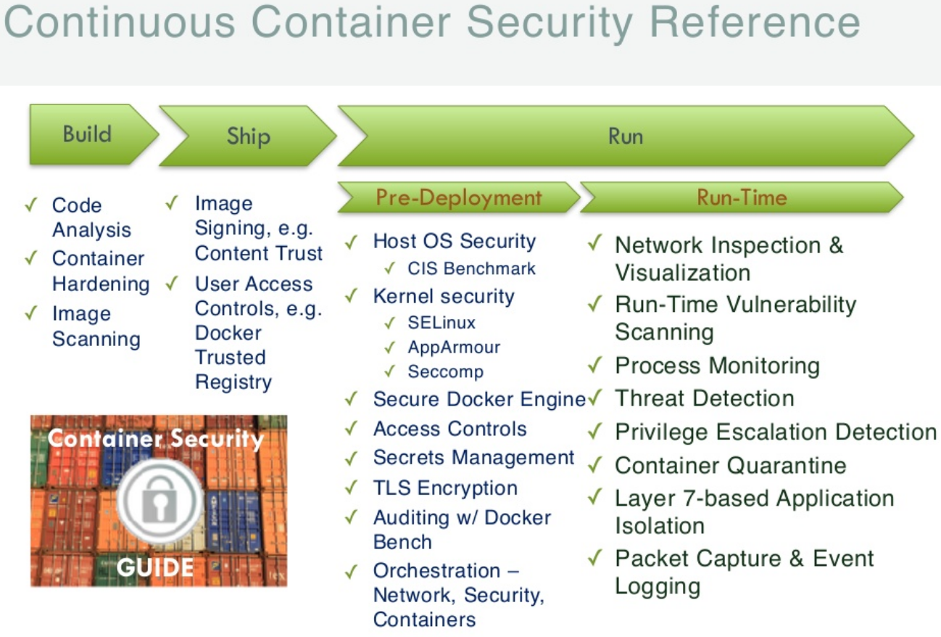
Securing containers
Notes:
https://www.slideshare.net/DieterReuter/docker-security-continuous-container-security

Slide 18
What we learned…
If you haven’t noticed, they’re here!
Massive support system
Widely used
Rapid adoption
Container security conceptually parallels standard practices

Slide 19
Hands-on session
Host: Update repo list
Host: Install Docker
Host: Find secure image
Host: Pull secure image
Host, container: Run image
Container: Run images as ?
Container: What’s running?
Host, container: Persistence
Host, container: Who can run images?
Host, container: Who can run images? (cont)
Challenge: PoLP Image build

Slide 20
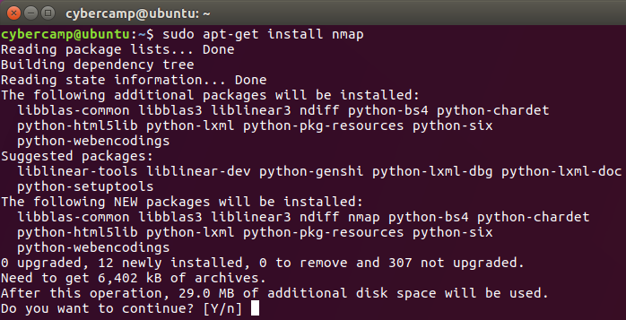
Update repo list
$ sudo apt-get update ??
$ wget https://github.com/rickpayne929
$ chmod +x ubuntu17_archiverepo.sh
$ ./ubuntu17_archiverepo.sh

Slide 21
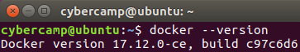
Install Docker
Connect to Archive Repos
$ sudo apt-get update ??
$ wget https://github.com/rickpayne929
$ chmod +x ubuntu_install_docker.sh
$ ./ubuntu_install_docker.sh
$ docker –version

Slide 22
Find secure image
https://hub.docker.com/
Official images
Alpine vulnerability
$ sudo docker search <image>
$ sudo docker search alpine --filter "is-official=true"

Slide 23
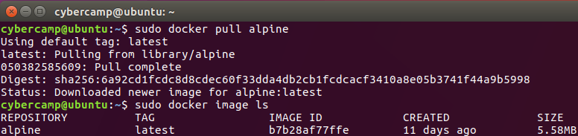
Pull secure image
https://hub.docker.com/
Official images – Version tag
Alpine vulnerability – What version?
$ sudo docker pull <image>
$ sudo docker image ls

Slide 24
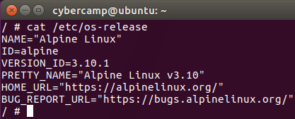
Run image
$ sudo docker run --help | egrep 'interactive|tty'
$ sudo docker run -it alpine
/ # cat /etc/os-release

Slide 25
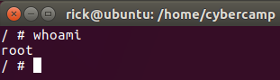
Run image as ?
/ # whoami
/ # exit
$ vi Dockerfile
Tomorrow → We’ll create a Dockerfile, add a standard user, build a container, and run a process as a non-root user.

Slide 26
Run image as ? (cont)
/ # whoami
Tomorrow → We’ll create a Dockerfile, add a standard user, build a container, and run a process as a non-root user.

Slide 27
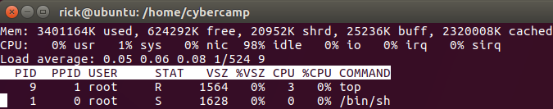
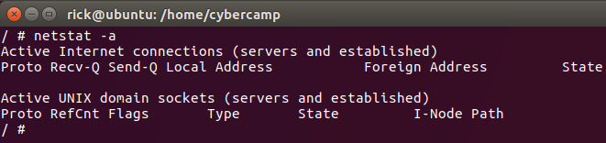
What’s running?
Default processes
/ # top
Open ports?
/# netstat -a

Slide 28
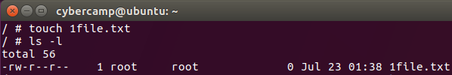
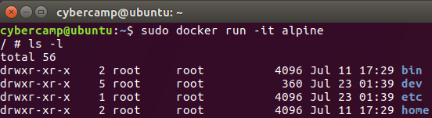
Persistence
Image vs container
/ # touch 1file.txt
/ # ls -l
/ # exit
$ sudo docker run -it alpine
/ # ls -l

Slide 29
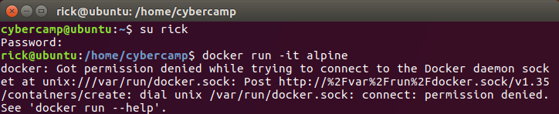
Who can run images?
Root users of course
Let’s take a PoLP approach on the host
$ getent group docker, less /etc/group
$ sudo adduser rick →
$ su rick
$ sudo docker run -it alpine

Slide 30
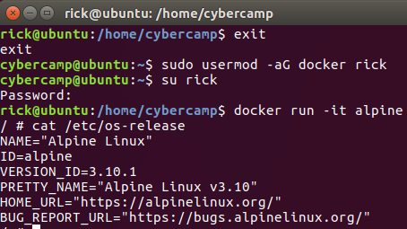
Who can run images? (cont)
$ exit
$ sudo usermod -aG docker rick
$ sudo docker run -it alpine
$ su rick
$ docker run -it alpine
/ # cat /etc/os-release

Slide 31
Challenge
Time permitting, let’s
create a Dockerfile
add a standard user
build the container
run a process as a non-root user
confirm the process is running non-root

Slide 32
Hands-on session #2
Host: Install Git
Host: CIS Scan
Host: CIS Audit Finding Remediation
Host: CIS Remediation Scan
Host: Build nmap container
Host, Container: Test nmap container
Host, Container: Test nmap container #2
Challenge: Remediate CIS Finding

Slide 33
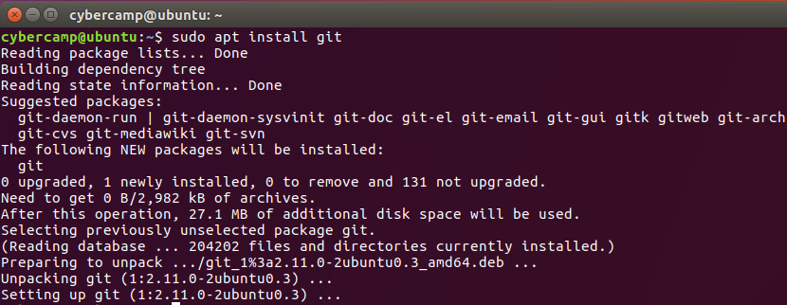
Install Git
$ sudo apt-get update
$ sudo apt install git
$ git --version

Slide 34
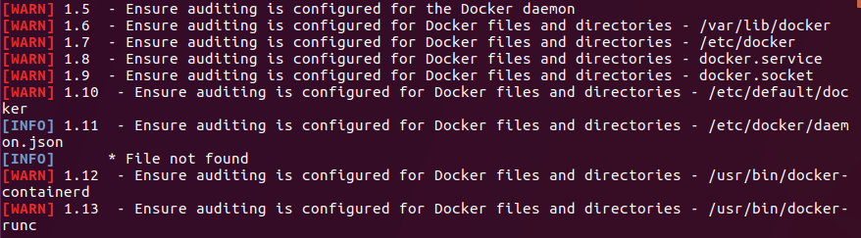
CIS Scan
$ git clone https://github.com/docker/docker-bench-security.git
$ cd docker-bench-security
$ sudo sh docker-bench-security.sh

Slide 35
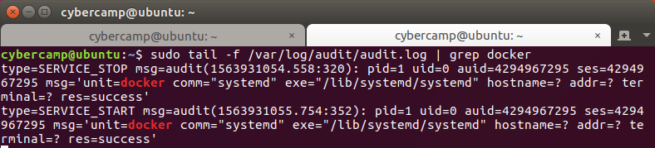
CIS Audit Finding Remediation
$ sudo apt install auditd
$ echo "-w /usr/bin/docker -p wa" | sudo tee -a /etc/audit/rules.d/audit.rules
$ sudo service auditd restart
$ sudo grep log_file /etc/audit/auditd.conf
Ctrl + shift + t, sudo tail -f /var/log/audit/audit.log | grep docker
Ctrl + PgUp, $ sudo service docker restart

Slide 36
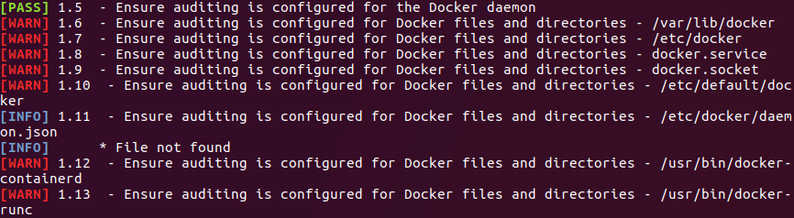
Host CIS Remediation Scan
$ cd docker-bench-security
$ sudo sh docker-bench-security.sh
$ cd ~

Slide 37
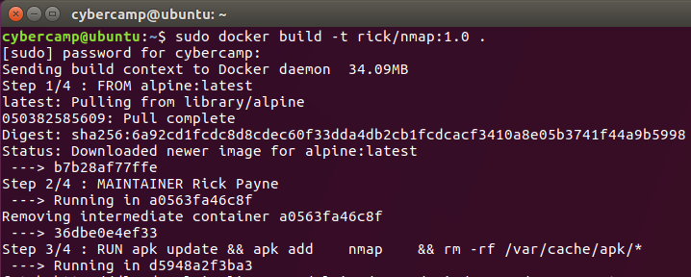
Build nmap container
Paste $ wget https://github.com/rickpayne929
into $ nano Dockerfile
$ sudo docker build –t rick/nmap:1.0 .

Slide 38
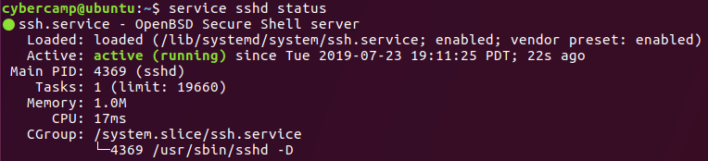
Test nmap container
$ sudo docker images ls
$ sudo netstat –tulnp
$ sudo apt install ssh –y
$ sudo service sshd status
$ sudo netstat –tulnp

Slide 39
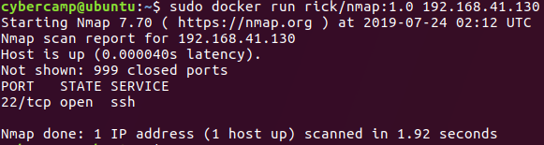
Test nmap container #2
$ sudo docker images ls
$ docker run –it rick/nmap –help
$ docker run –it rick/nmap:1.0 –help
$ ipconfig | grep inet
$ docker run –it rick/nmap:1.0 <inet IP>

Slide 40
Challenge: Remediate CIS Finding
Time permitting, let’s
Identify another CIS finding
Remediate
Rescan
Confirm remediation

Slide 41
Hands-on session #3
Host: Docker Mgmt Commands
Host: Docker Mgmt Commands #2
Host, Container: Cleanup -> Web Server Launch
Host, Container: Host <-> Container Volume
Host, Container: Container – root by default?
Host: Create user-level image
Challenge: Image Vulnerability Scan

Slide 42
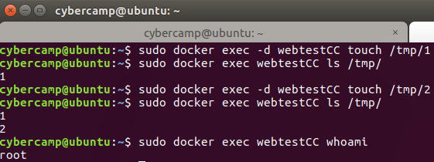
Docker Mgmt Commands
$ sudo docker –help
$ sudo docker image –help
$ sudo docker inspect
$ sudo docker exec –d <image> touch /tmp/1

Slide 43
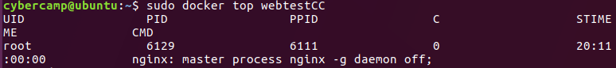
Docker Mgmt Commands #2
$ docker run --name webtestCC -p 80:80 -d nginx
What’s the container’s resource (CPU, mem) usage?
Running process? Ports exposed?
Process running as what user?
$ sudo docker ps -> top -> stats

Slide 44
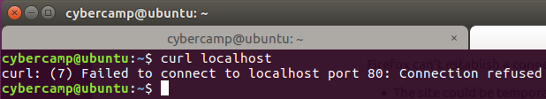
Cleanup -> Web Server Launch
$ sudo docker container kill webtestCC
$ sudo docker rm webtestCC
$ sudo docker run --name nginxtest -v /home/cybercamp/index.html:/usr/share/nginx/html/index.html:rw -d nginx
$ curl localhost, open Firefox -> goto localhost

Slide 45
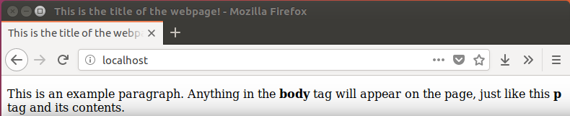
Host <-> Container Volume
$ sudo docker run --name nginxtest -v /home/cybercamp/index.html:/usr/share/nginx/html/index.html:rw -p 80:80 -d nginx
$ curl localhost, open Firefox -> goto localhost
$ gedit index.html
$ sudo docker container nginx restart

Slide 46
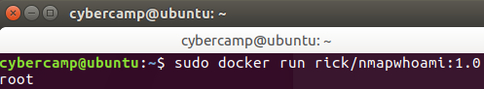
Container – root by default?
$ wget https://github.com/rickpayne929
$ sudo docker build –t rick/nmapwhoami:1.0 .

Slide 47
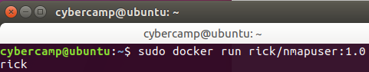
Create user-level image
$ wget https://github.com/rickpayne929
$ sudo docker build –t rick/nmapuser:1.0 .

Slide 48
Challenge: Image Vulnerability Scan
Time permitting, let’s
Download open source scanner
Scan image
Generate Report
Fix 1 finding
Report and compare

Slide 49
References
Special Publication 800-190 - Application Container Security Guide. NIST. Retrieved from https://nvlpubs.nist.gov/nistpubs/SpecialPublications/NIST.SP.800-190.pdf
Docker overview. Docker. Retrieved from https://docs.docker.com/engine/docker-overview/
Infographic: Docker Ecosystem. IT Briefcase. Retrieved from http://www.itbriefcase.net/infographic-docker-ecosystem-2014-year-in-review
Docker Threat Modeling. Dr. Wetter. Retrieved from https://www.owasp.org/images/1/17/Dirk_Wetter_-_Docker_Security_Brussels.pdf

Slide 50
References
Additional reference citations listed in slide notes

